Slide 1
Introduction to
International Business Administration

Slide 2
Government Policy and International Trade
Notes:
This is a test

Slide 3
Prof. Dr. Amit Shah
Notes:
This is a test

Slide 4
Governments and Trade
Slide 5-2
Theory says that free trade benefits everyone the most.
More often governments manage trade
(“… level the playing-field”)
  Restriction of imports: protectionist intervention
  Promotion of exports
  Trade promotion and FDI incentives
Is free-trade “Good” or “Bad”?
  Social issues related to free-trade
  Implications for business and individual groups

Slide 5
Seven Main Instruments of Trade Policy
Tariffs
Subsidies
Import quotas
Export restraints
Local content requirements
Administrative policies
Anti-dumping policies

Slide 6
1. Tariffs
Taxes levied on imports (also sometimes on exports)
  Specific tariff: fixed charge for each good imported
  Ad valorem tariff: a percent of imported good’s value
Notes:
Fixed rate: 3dollars per barrel of oil
Ad valorem: percentage on the value

Slide 7
1. Tariffs
Who gains:
  Government. Gains revenue and tariffs are easier to collect than other types of taxes.
  Domestic producers (at least in the short run)
  Employees of protected industries keep their jobs
Who loses:
  Consumers who pay higher prices
  The economy which remains inefficient
  Employees of protected industries who don’t develop new skills
Notes:
Domestic producers. Are protected in the short run

Slide 8
2. Subsidies
Government support to domestic producers
  Cash grants, low-interest loans, tax breaks, equity participation, government purchases
  Aim to achieve lower costs to
    Compete against cheaper imports
    Gain export markets
    Increase domestic employment
    Help local producers achieve first-mover advantage in emerging industries
Governments
  Tax individuals… to pay for subsidies
  Consumers buy more expensive goods with lower disposable incomes
Notes:
Subsidies: government supports branches of the industry financially (direct investment; no taxes; free …)
Why does government does this:
Attract companies
→ More jobs → benefits government, employees which then reinvest in local communitiese

Slide 9
3. Import Quotas
Import quota: government specifies how much of what product can be imported from which countries
  Sugar into U.S. (Tariff Rate Quota)
Notes:
August 25, 2021 -- The United States government on Wednesday said it was increasing its lower-tariff sugar import quota for fiscal year 2021 by 90,100 tonnes (raw value) as it tries to increase short-term supplies in the domestic market. With the additional of the so-called TRQ quota, the total volume entering the U.S. at lower tariff will go to 1.2 million tonnes, more than the volume the country agreed to within World Trade Organization rules that is 1.11 million tonnes.
How much can be imported of a certain good: → after a certain percentage higher tariffs

Slide 10
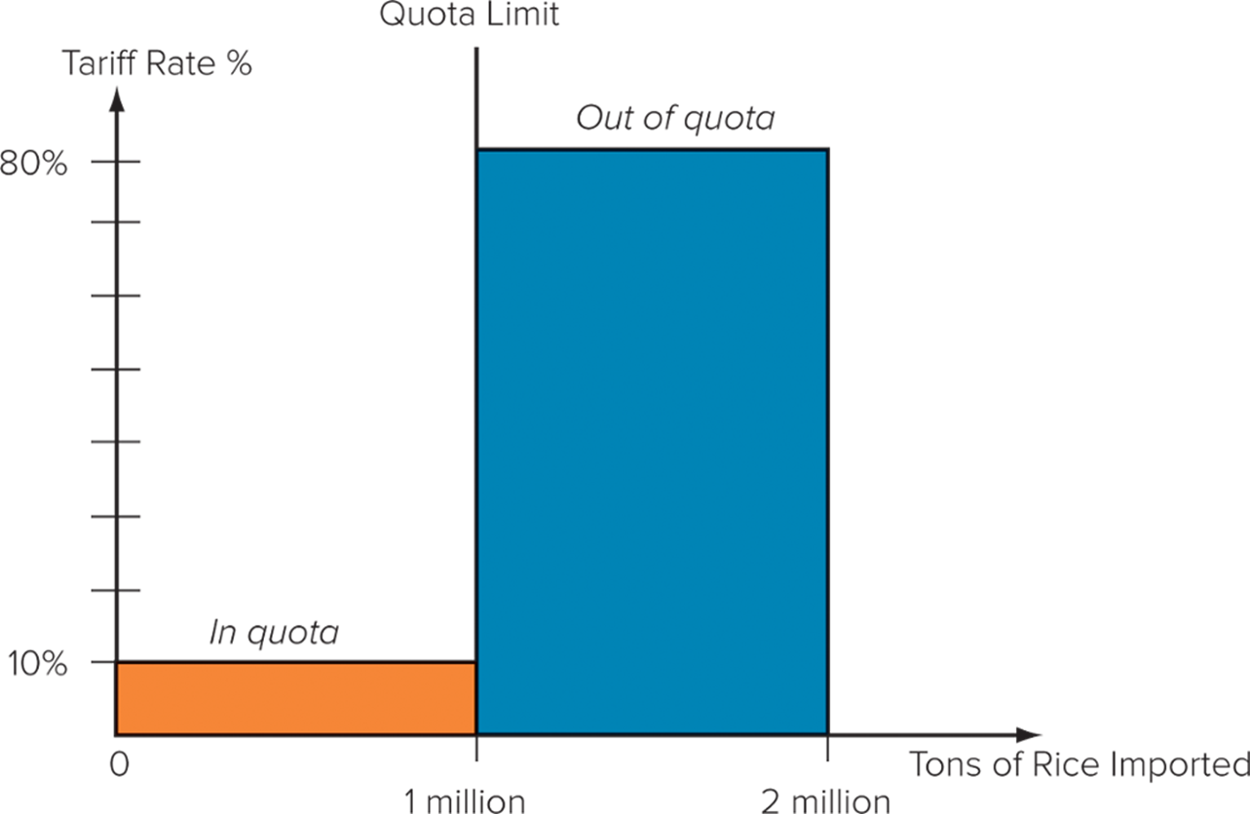
Hypothetical Tariff Rate Quota
Notes:
As illustrated in Figure, an ad valorem tariff rate of 10 percent might be levied on 1 million tons of rice imports into South Korea, after which an out-of-quota rate of 80 percent might be applied. Thus, South Korea might import 2 million tons of rice, 1 million at a 10 percent tariff rate and another 1 million at an 80 percent tariff. Tariff rate quotas are common in agriculture, where their goal is to limit imports over quota.

Slide 11
4. Export Restraints
Export Tariffs and Bans
Export tariff: tax placed on the export of a good.
  Goal is to discriminate against exporting to ensure supply.
Export ban: policy that partially or entirely restricts the export of a good.
  Ban of exports of U.S. crude oil in 1975 to ensure sufficient supply of domestic oil at home.
  Wheat from Russia (keep down domestic prices)
  Rare Earths from China (geo-political reasons)
  Cocoa from Ivory Coast (reduce terrorist funds)
  Beef from Argentina (keep down domestic prices)
  Software from the U.S. (national security)
  Nickel ore from Indonesia (encourage domestic refiners)
Notes:
Export tariff: ban/tariff on wanting to export sth.

Slide 12
5. Local Content Requirements
Local Content Requirements
  A product’s certain percentage has to be produced domestically with local raw materials
  Used by less developed countries (LDCs) to
    Achieve technology transfer, skills transfer
    Shift manufacturing to a higher technological level
  Similar effects to those of import quotas

Slide 13

6. Administrative Policies
Administrative policies
  Bureaucratic rules that make it difficult for imports to enter a country
    French restrictions on Japanese autos
    It takes 3.5 weeks for a container of auto parts to pass through customs in the Congo
Notes:
It has been argued that the Japanese are the masters of this trade barrier. In recent decades, Japan’s formal tariff and nontariff barriers have been among the lowest in the world. However, critics charge that the country’s informal administrative barriers to imports more than compensate for this.
Red tape: paperwork
Require a lot of paperwork → protects local community

Slide 14
7. Anti-dumping Policies
Dumping: selling goods in a foreign market below their cost of production or below their “fair” market value.
Anti-dumping policies punish producers who dump and protect domestic producers
Notes:
Dumping: flood a market

Slide 15
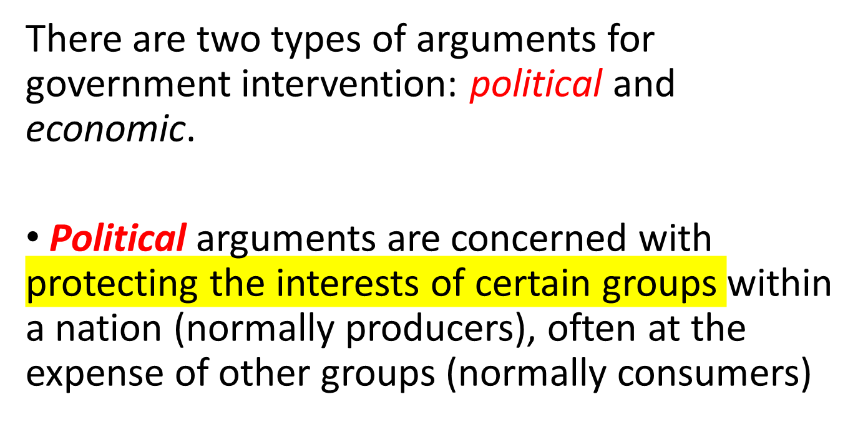
THE CASE FOR GOVERNMENT INTERVENTION

Slide 16
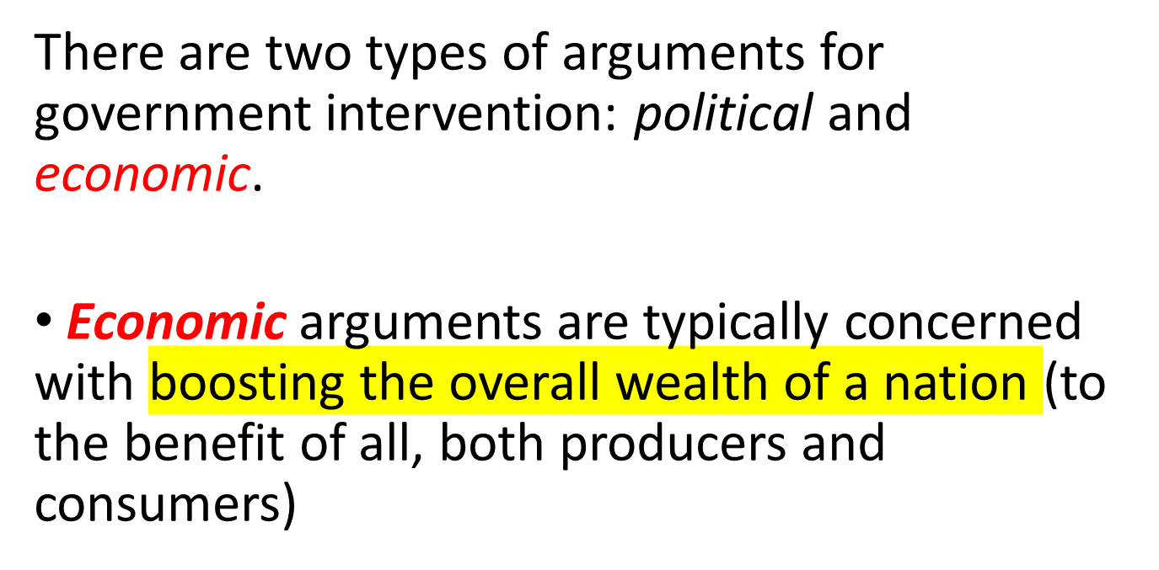
THE CASE FOR GOVERNMENT INTERVENTION

Slide 17
Political Arguments for Intervention
National security
Individual industries and jobs protected
Retaliation (revenge)
Consumer protection (health, safety)
Furthering foreign policy objectives
Protecting Human Rights
Other political or economic objectives

Slide 18
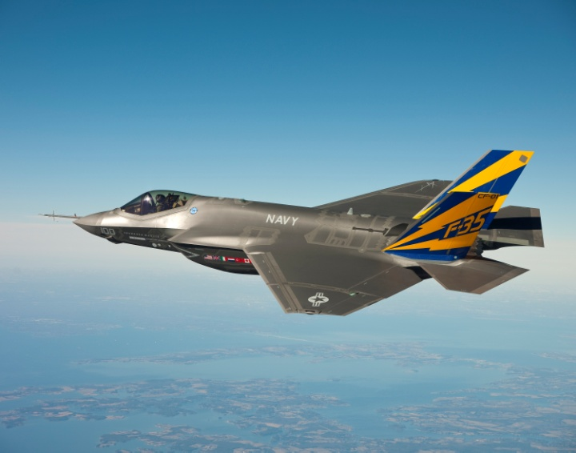
National Security
Protecting industries such as aerospace or electronics because they are important for national security. “Protecting the industrial base.”
Notes:
Get a appoval to sell, because some industries needed for war

Slide 19
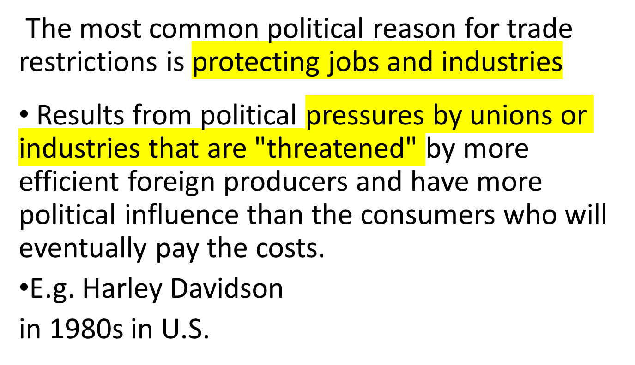
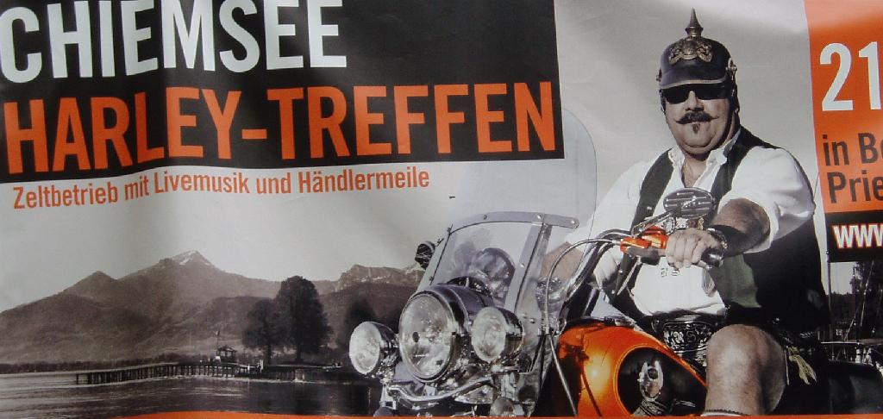
Protecting Jobs and Industries
Notes:
The 1980s comeback of Harley-Davidson motorcycles is often touted as an example of how active trade policy can help the American economy by “creating a level playing field.” Here’s how The New York Times reported it back in 1983:
In an unusually strong protectionist action, President Reagan today ordered a tenfold increase in tariffs for imported heavyweight motorycles. The impact of Mr. Reagan’s action, which followed the unanimous recommendation of his trade advisers, is effectively limited to Japanese manufacturers, which dominate every sector of the American motorycycle market. The action was exceptional for protecting a single American company, the Harley-Davidson Motor Company of Milwaukee, the sole surviving American maker of motorcycles. The only comparable trade action by this Administration, the President’s decision last May to impose quotas on sugar imports for the first time since 1974, was aimed at an entire industry.

Slide 20
Retaliation
When governments take, or threaten to take, specific actions, other countries may remove trade barriers; however, if threatened governments don’t back down, tensions can escalate, and new trade barriers may be enacted
Once up, they are hard to get back down.
e.g. EU vs. China in solar panels (2013)
Notes:
July 27, 2013 (Reuters) -- After six weeks of talks, the EU’s trade chief and his Chinese counterpart sealed the deal over the telephone, setting a minimum price for panels from China near spot market prices.
European solar panel makers accuse China of benefitting from huge state subsidies, allowing them to dump about 21 billion euros ($28 billion) worth of below-cost solar panels in Europe last year, putting European firms out of business.
Other European industries that have accused China of dumping have faced imports of about 1 billion euros a year.
Europe planned to impose hefty tariffs from August 6 but, wary of offending China’s leaders and losing business in the world’s No. 2 economy, a majority of EU governments - led by Germany - opposed the plan, which led to the compromise deal.
“We found an amicable solution,” EU Trade Commissioner Karel De Gucht said. “I am satisfied with the offer of a price undertaking submitted by China’s solar panel exporters,” he said, referring to the minimum price for China’s imports.

Slide 21
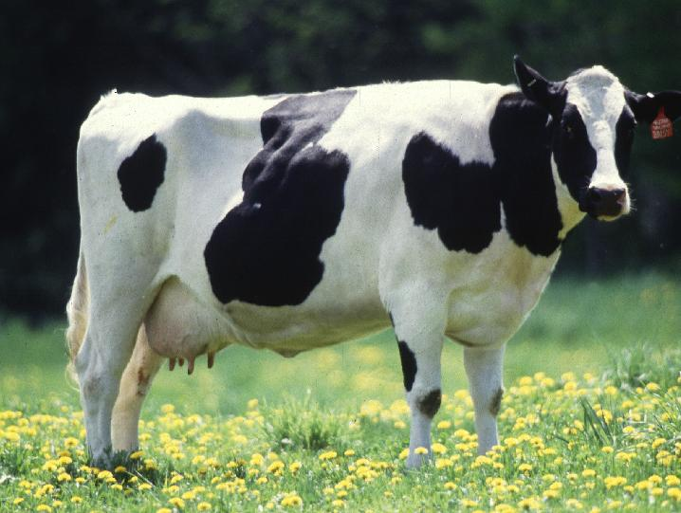
Protecting Consumers
Consumer protection can also be an argument for restricting imports
  Genetically altered crops or animals
  Additives to crop foods or animals
  Contamination of foods

Slide 22

Protecting Consumers
Consumer protection can also be an argument for restricting imports
  Harmful substances, such as lead, in products
  Products that don’t meet safety standards (Smart in U.S.)
  ‘knock off’ products

Slide 23
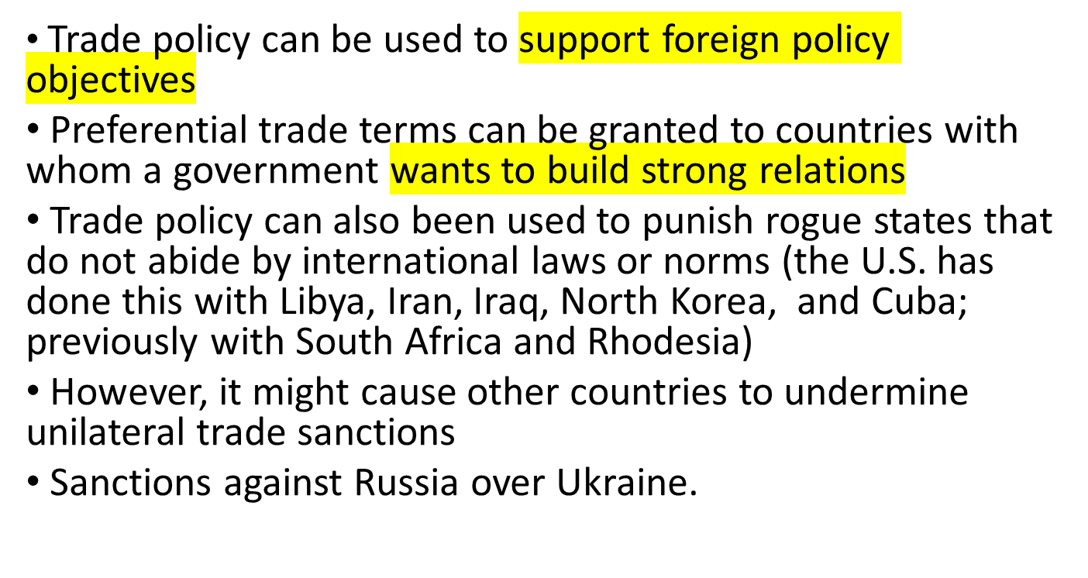

Furthering Foreign Policy Objectives
Notes:
MFN = most favored nation status → free trade; significantly reduced tariffs

Slide 24
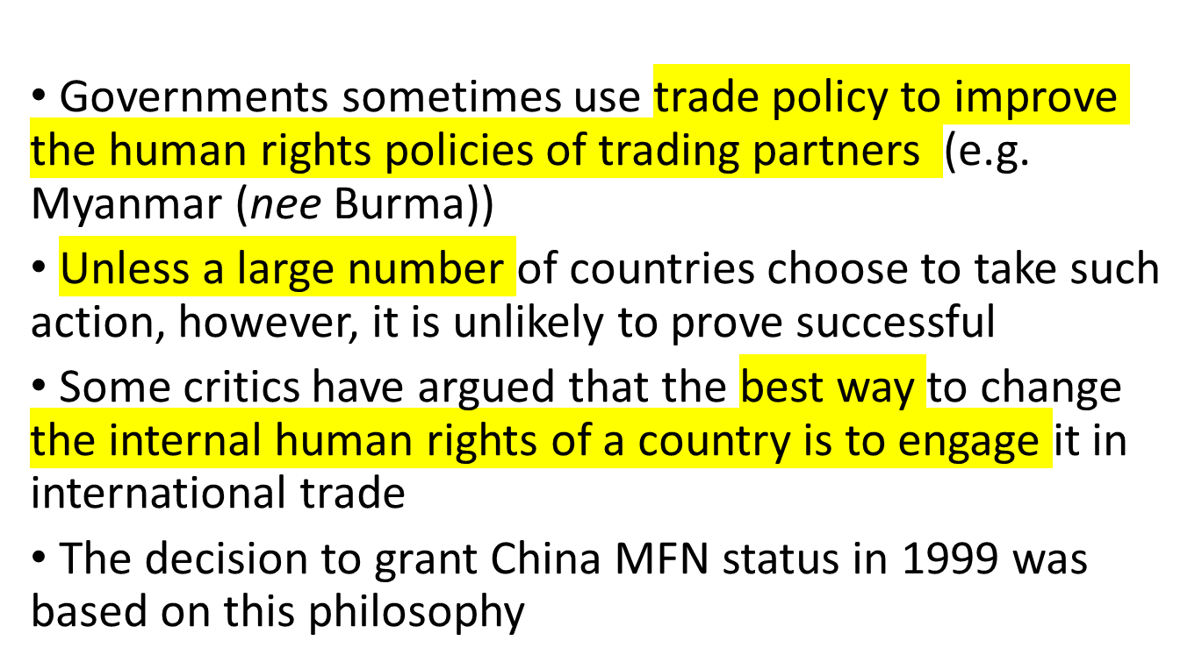
Protecting Human Rights

Slide 25
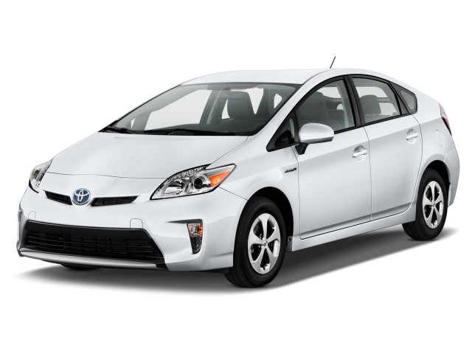
Other Arguments for Intervention
Infant industry protection
Support ‘desirable’ industries
  Solar and wind power
  Hybrid and electric cars
When Hong Kong
eliminated subsidies for
electric cars in 2017, sales
of Tesla cars fell to zero.
Notes:
Infant industry : protecting up and coming industries
Desirable industries: what a government decries as worthy or desired for the future

Slide 26
Development of the World Trading System
International Trading Framework
  Evolved since World War I I to govern world trade.
  In its first 50 years, the framework was known as the General Agreement on Tariffs and Trade (G A T T).
  Since 19 95, the framework has been known as the World Trade Organization (W T O).
Notes:
Economic arguments support unrestricted free trade. While many governments have recognized the value of these arguments, they have been unwilling to unilaterally lower their trade barriers for fear that other nations might not follow suit.

Slide 27
Development of the World Trading System
From Smith to the Great Depression
  Repeal of British Corn Laws was first free trade government policy; British continued pushing for trade liberalization.
  But up until the Great Depression of the 1930s, most countries had some degree of protectionism.
  U.S. enacted the Smoot-Hawley Act (19 30): created significant import tariffs on foreign goods.
    Damaged employment abroad.
Other nations took similar steps, and as the depression deepened, world trade fell further.
Notes:
Free trade as a government policy was first officially embraced by Great Britain in 1846, when the British Parliament repealed the Corn Laws. The Corn Laws placed a high tariff on imports of foreign corn. The objectives of the Corn Laws tariff were to raise government revenues and to protect British corn producers. There had been annual motions in Parliament in favor of free trade since the 1820s, when David Ricardo was a member. However, agricultural protection was withdrawn only as a result of a protracted debate when the effects of a harvest failure in Great Britain were compounded by the imminent threat of famine in Ireland. Faced with considerable hardship and suffering among the populace, Parliament narrowly reversed its long-held position.
During the next 80 years or so, Great Britain, as one of the world’s dominant trading powers, pushed the case for trade liberalization, but the British government was a voice in the wilderness.

Slide 28
Development of the World Trading System
19 47 to 19 79: G A T T, Trade Liberalization, and Economic Growth
  The General Agreement on Tariffs and Trade (G A T T) was established in 19 47.
    Multilateral agreement to liberalize trade and gradually eliminate barriers to trade.
    Membership grew from 19 to more than 120 nations.
    Tariff reduction was spread over eight rounds.
    Very successful in early rounds.
G A T T superseded by the World Trade Organization (W T O).
Notes:
In its early years, the GATT was by most measures very successful. For example, the average tariff declined by nearly 92 percent in the United States between the Geneva Round of 1947 and the Tokyo Round of 1973 to 1979. Consistent with the theoretical arguments first advanced by Ricardo, the move toward free trade under the GATT appeared to stimulate economic growth.

Slide 29
Development of the World Trading System
19 80 to 19 93: Protectionist Trends
  Trading system erected by the G A T T came under strain as pressures for greater protectionism increased.
  Japan’s economic success strained what had been more equal trading patterns.
  Persistent trade deficits by the U.S caused significant problems in some industries and political problems for the government.
  Many countries found that although G A T T limited the use of tariffs, other forms of intervention had the same effect but did not technically violate G A T T.
Notes:
Bilateral voluntary export restraints (VERs) circumvented GATT agreements, because neither the importing country nor the exporting country complained to the GATT bureaucracy in Geneva—and without a complaint, the GATT bureaucracy could do nothing.

Slide 30

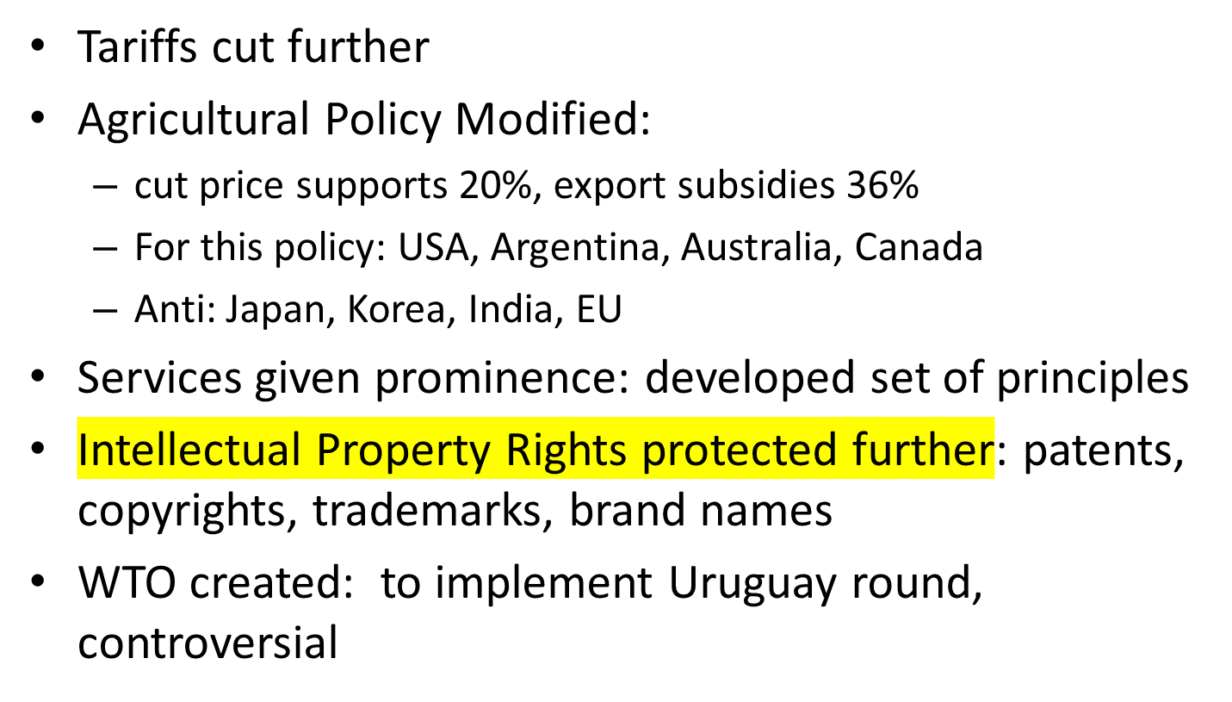
Uruguay Round of GATT negotiations

Slide 31
Development of the World Trading System
W T O: Experience to Date
  Members account for 98 percent of world trade.
  It was hoped that it would emerge as an effective advocate and facilitator of future trade deals.
  Started strong but has fallen off since late 19 90s.
  Brexit and Trump administration indicated a return to greater protectionism.
Notes:
By 2020, the WTO had 164 members, including China, which joined at the end of 2001, and Russia, which joined in 2012.

Slide 32
Development of the World Trading System
  W T O as global police.
    First two decades suggest that it is having a positive effect.
    Resolved three-fourths of cases via informal consultations.
  Expanded trade agreements.
    Uruguay Round extended global trading rules to cover services.
    Telecommunications, financial services.
    Foreign direct investment.
Notes:
Seventy countries agreed to dramatically lower or eradicate barriers to foreign direct investment in their financial services sector. The United States and the European Union (with minor exceptions) are fully open to inward investment by foreign banks, insurance, and securities companies. As part of the deal, many Asian countries made important concessions that allow significant foreign participation in their financial services sectors for the first time.

Slide 33
Development of the World Trading System
W T O: Unresolved Issues and the Doha Round
  Antidumping actions:
    Encourage members to strengthen regulations governing the imposition of antidumping duties.
Protectionism in agriculture:
Concerned with high level of tariffs and subsidies in agricultural sector of many economies.
Protection of intellectual property:
Members believe protection of intellectual property rights is essential to the international trading system.
Notes:
TRIPS obliges WTO members to grant and enforce patents lasting at least 20 years and copyrights lasting 50 years.

Slide 34
Development of the World Trading System
  Market access for nonagricultural goods and services.
    Tariffs on services remain higher than on industrial goods.
  A new round of talks: Doha
    Ongoing since 2001.
    Concerned with cutting tariffs on industrial goods and services, phasing out subsidies to agricultural producers, reducing barriers to cross-border investment, and limiting use of antidumping laws.
    → Drop as many regulations as possible
Notes:
As of 2018, the goal for the Doha round was to reduce tariffs for manufactured and agricultural goods by 60 to 70 percent and to cut subsidies to half of their current level—but getting nations to agree to these goals was proving exceedingly difficult.

Slide 35
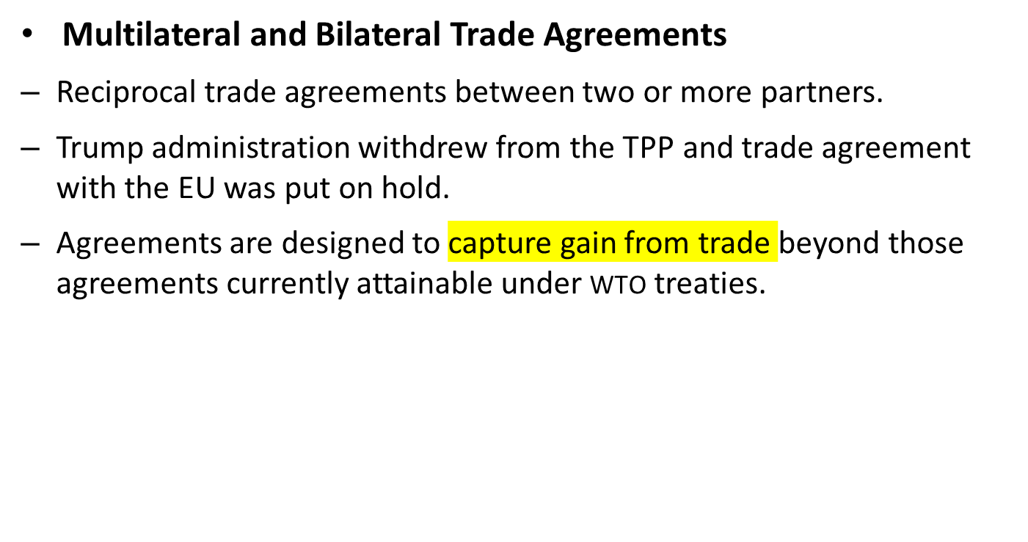
Development of the World Trading System
Notes:
In response to the apparent failure of the Doha Round to progress, many nations have pushed forward with multilateral or bilateral trade agreements, which are reciprocal trade agreements between two or more partners. For example, in 2014 Australia and China entered into a bilateral free trade agreement.
Multilateral and bilateral trade agreements are designed to capture gain from trade beyond those agreements currently attainable under WTO treaties.

Slide 36
Development of the World Trading System
The World Trading System Under Threat
  Two events suggest that global consensus on free trade isn’t accurate:
    Decision by the British to withdraw from the E U.
    2016 election of Donald Trump, who appeared to hold mercantilist views on trade.
      Withdrew from Trans-Pacific Partnership.
      Placed tariffs on certain imports.
      Renegotiated N A F T A.
      Expressed hostility to the W T O.
Notes:
In late 2019, the Trump administration also blocked replacements for two judges on the WTO’s appellate body, which hears appeals in trade disputes. With just one judge remaining, it will no longer be able to hear new cases, which effectively undermines the WTO’s enforcement mechanism. The significance of these developments is that heretofore both Britain and America have been leaders in the global push toward greater free trade.

Slide 37
Development of the World Trading System
In 2020, the Director General of the W T O noted that in its first 25 years, the binding rules governing international trade facilitated dramatic growth in cross-border activity.
Also noted the W T O faces unmatched challenges today that will affect the global economy for decades.
Notes:
The Director General of the WTO is referring to the rise of tariffs, the ongoing trade dispute between the world’s two largest economies, the United States and China, and the apparent belief of the Trump administration that bilateral agreements, and managed trade deals, are superior to the rules-based multilateral trade order embodied in the WTO.

Slide 38
IMPLICATIONS FOR MANAGERS
Trade Barriers and Firm Strategy
Trade barriers raise the cost of exporting products to a country
Voluntary export restraints (VERs) may limit a firm’s ability to serve a country from locations outside that country
To conform to local content requirements or to get behind trade barriers, a firm may have to locate more production activities in a given market than it would otherwise
All of these can raise the firm’s costs above the level that could be achieved in a world without trade barriers
They can be changed at any time by the governments involved

Slide 39
Policy Implications
International firms have an incentive to lobby for free trade, and keep protectionist pressures from causing them to have to change strategies
While there may be short run benefits to having governmental protection in some situations, in the long run these can backfire and other governments can retaliate (First Solar Corp. says they are “…one politician’s vote from bankruptcy.”)

Slide 40
End of Trade Lecture

